Slide 1


Code Crackers
CODE CRACKER CLUB WHERE KNOWLEDGE FLOWS, EVERYONE GROWS.

Slide 2



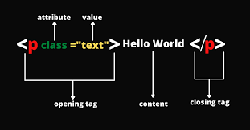
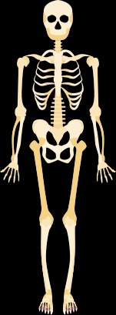

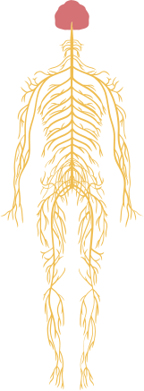
What is HTML, CSS, JavaScript ?

Slide 3
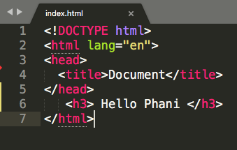
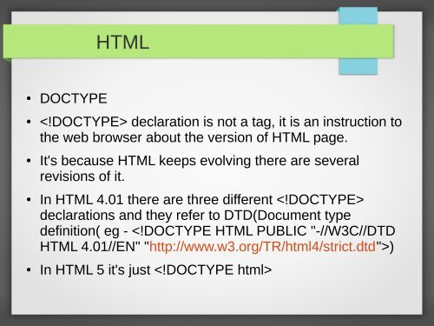
What is DoctypeHTML HTML ? and it is written ?
The <!DOCTYPE html> declaration defines that this document is an HTML5 document.
It’s not a tag It is instruction to web browsers about version of HTML.
It’s not a tag It is instruction to web browsers about version of HTML.

Slide 4
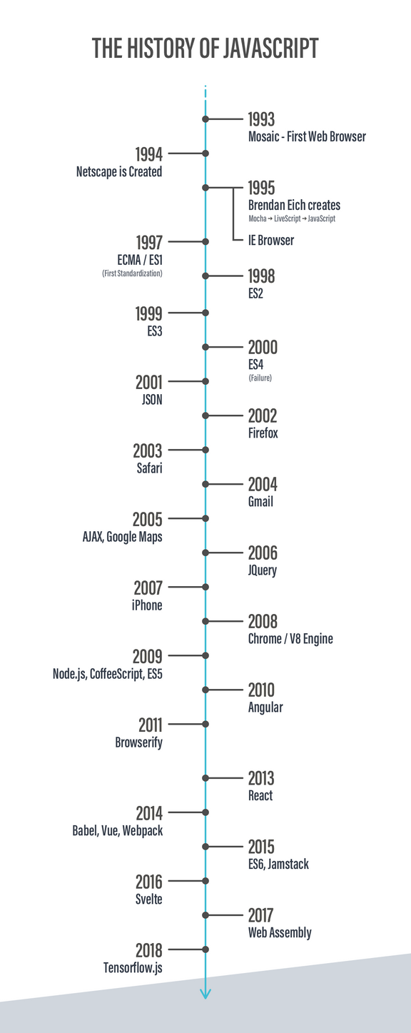
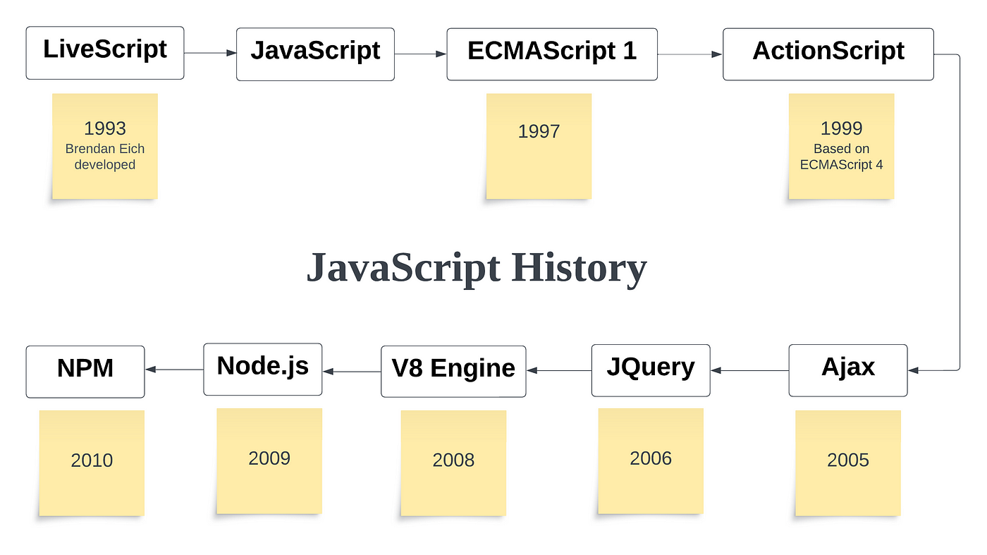
History of JavaScript

Slide 5
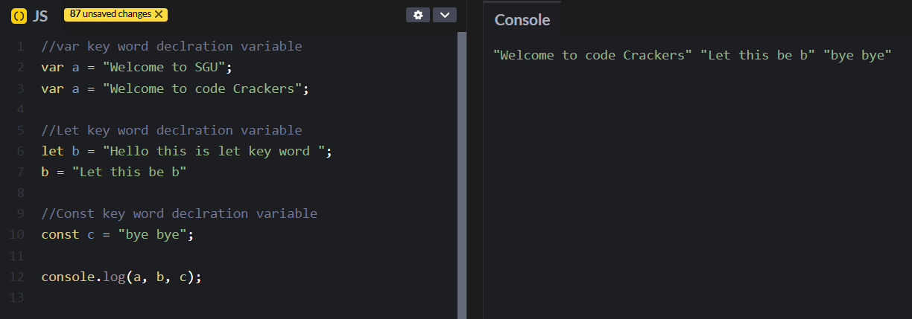
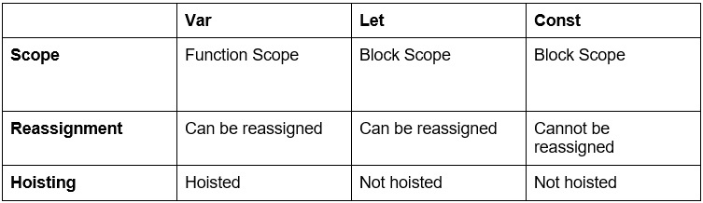
Variables

Slide 6
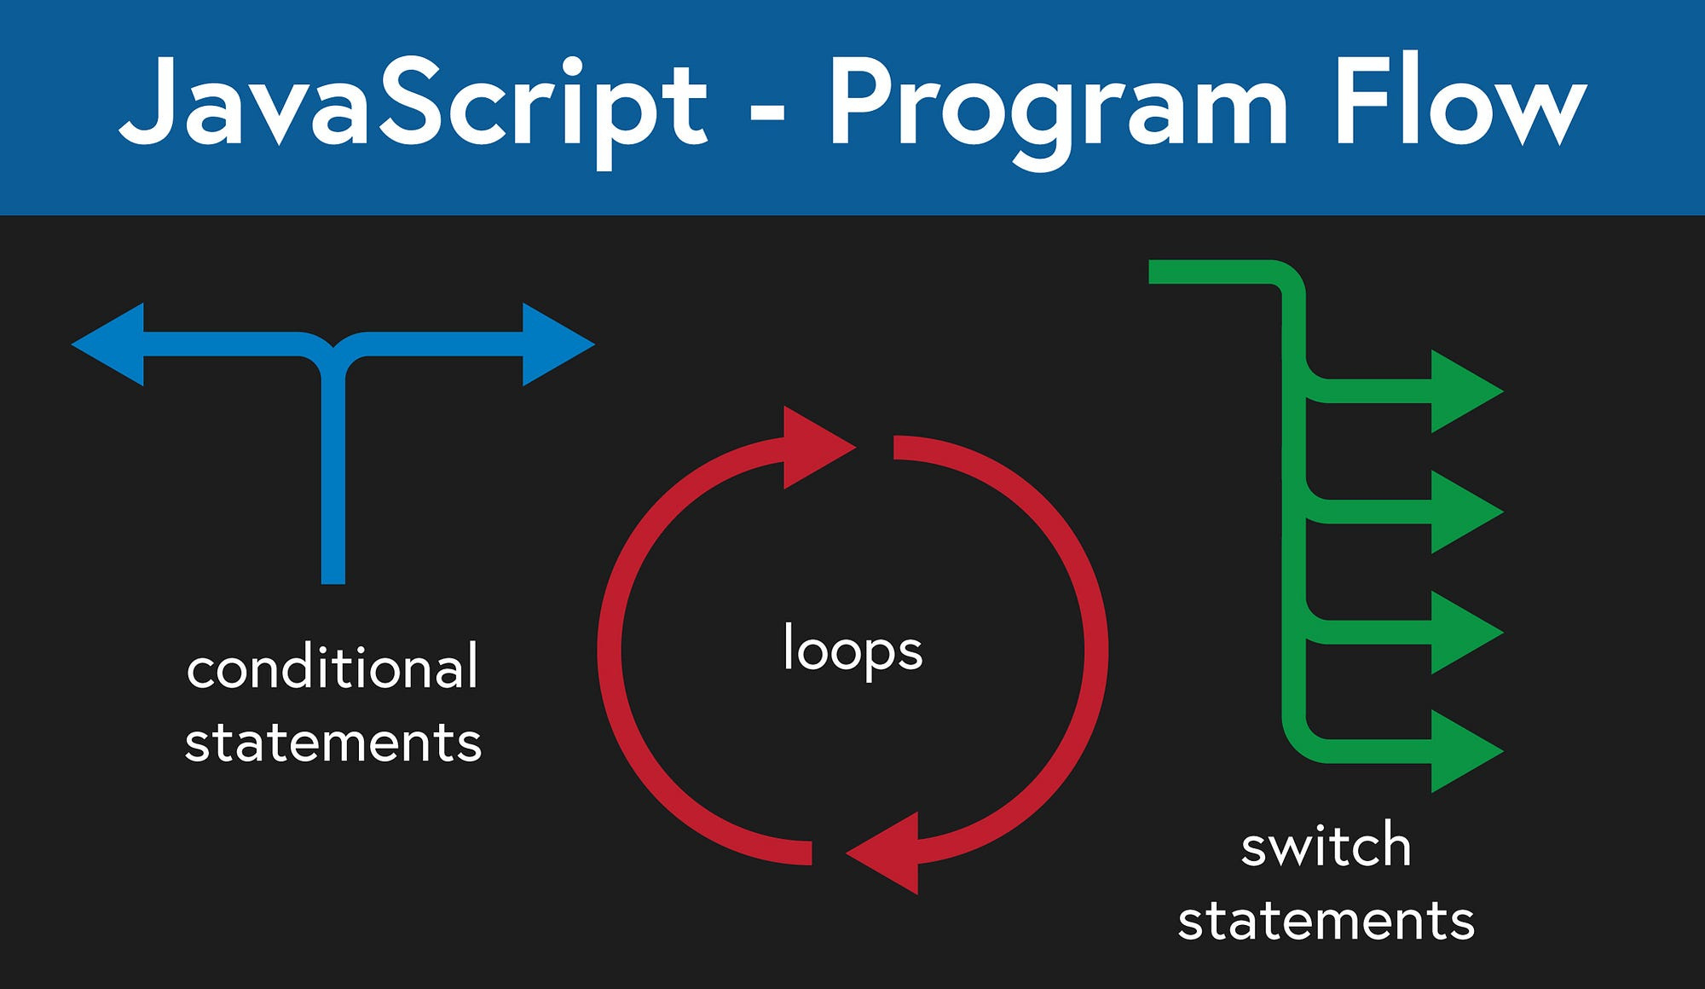
Control flows

Slide 7

Loops
//for loops
for(i=1;i<=5;i++){
console.log(i);
}
//while loop
console.log("j is here :");
let j = 0;
while(j<10){
j++;
console.log(j);
}

Slide 8
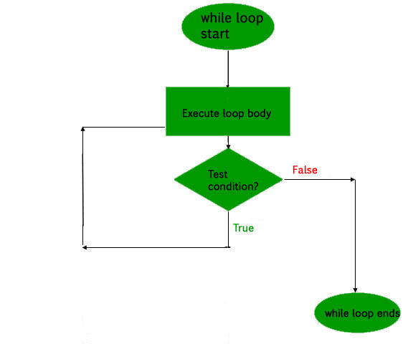
Do while loop
//do while loop
let k = 0;
do{
console.log("printing K :",k);
k++;
}while (k<10);

Slide 9


Functions
OutPut
function add(){
return 2 + 5;
}
let addition = add();
console.log(addition)
7

Slide 10
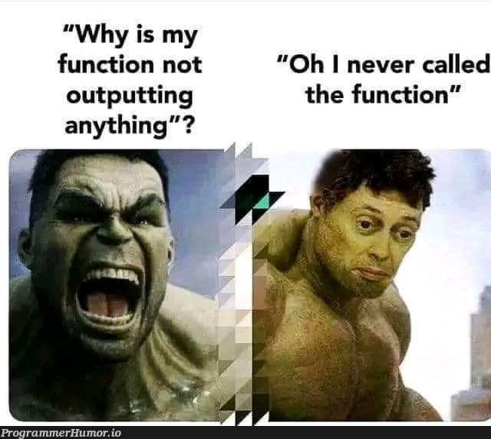
Exploring functions
Function statement & declaration
function fun(x,y){
return x + y;
};
//console.log(fun(1,2));

Slide 11
Exploring functions
Function Expression
Anonymous Function
const name = function fun(x,y){
return x + y;
};
console.log(name(1,2));
function (x,y){
return x + y;
};

Slide 12

Exploring functions
Arrow function
First class functions
const add = (a,b) =>{
return a + b;
};
//single line arrow function
const add = (a,b) => a + b;
//if 1 parameter then no need ()
const square = a => a * a;

Slide 13
Exploring functions
First class functions
function createGreeter(name) {
return function() {
console.log(`Hello, ${name}!`);
};
}
const greetJohn = createGreeter("John");
greetJohn();
// Invokes the returned function

Slide 14
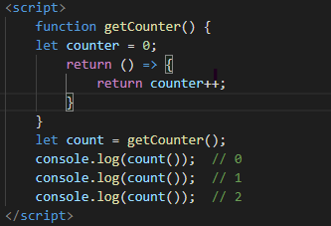
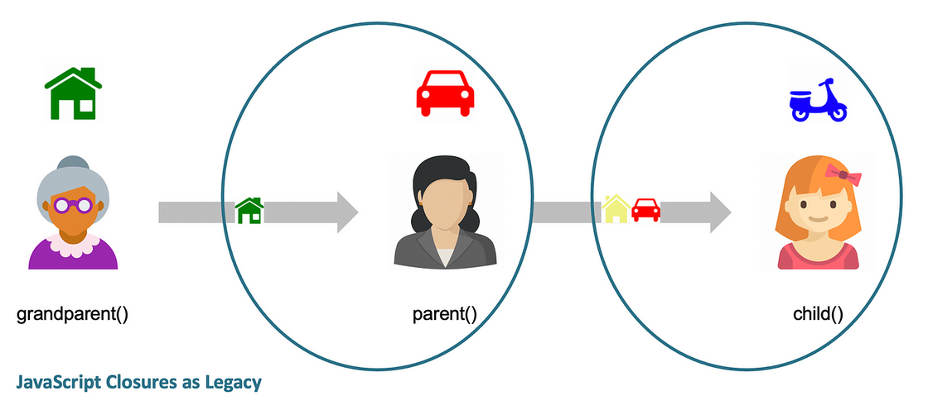
Exploring functions
First class functions

Slide 15
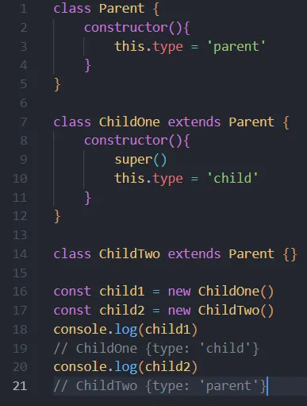
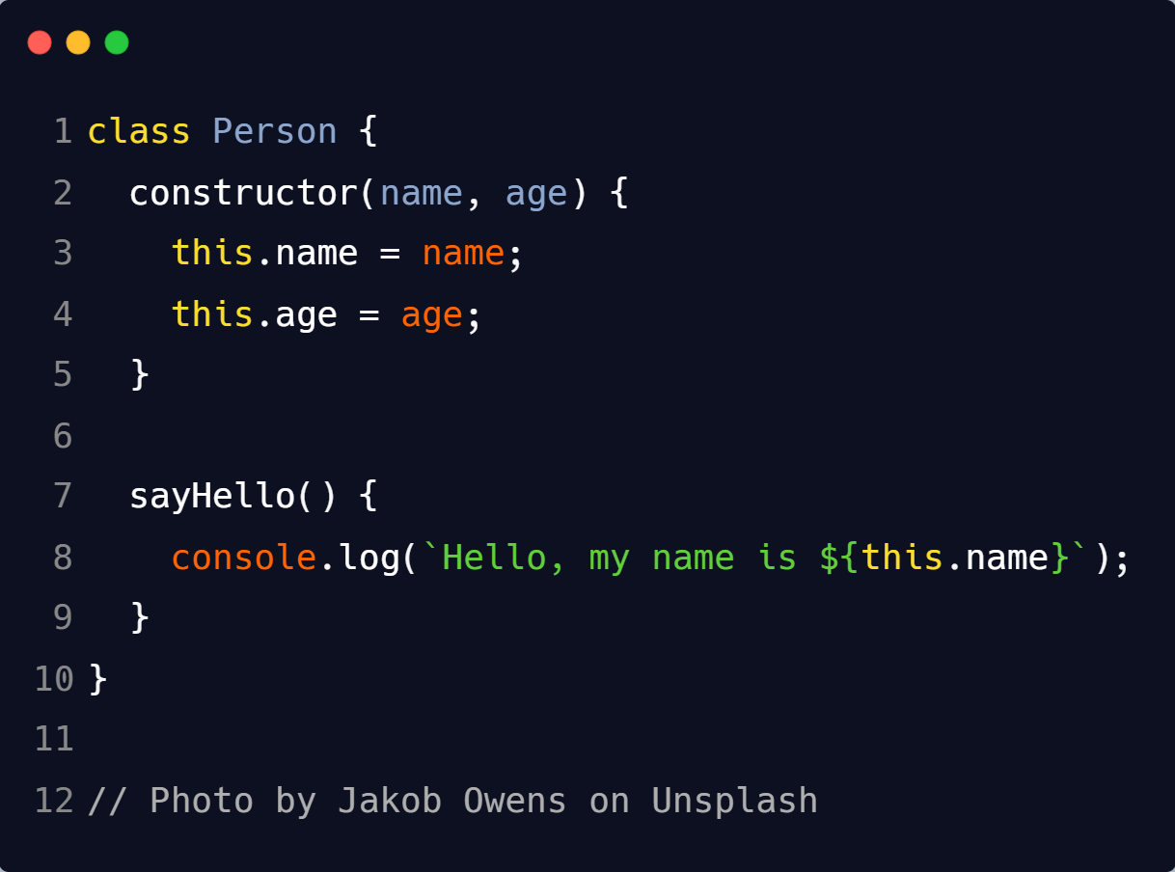
Classes
Class with it’s constructor

Slide 16
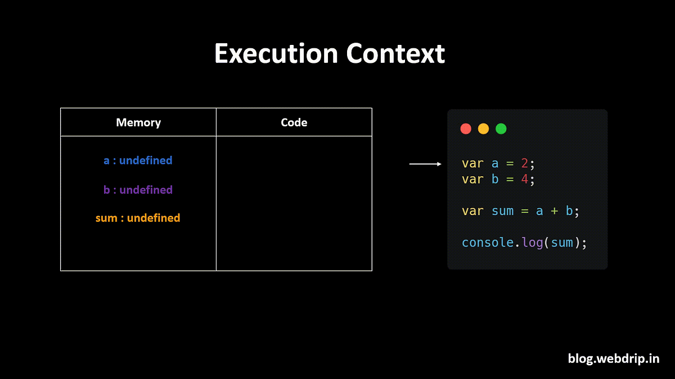

Slide 17
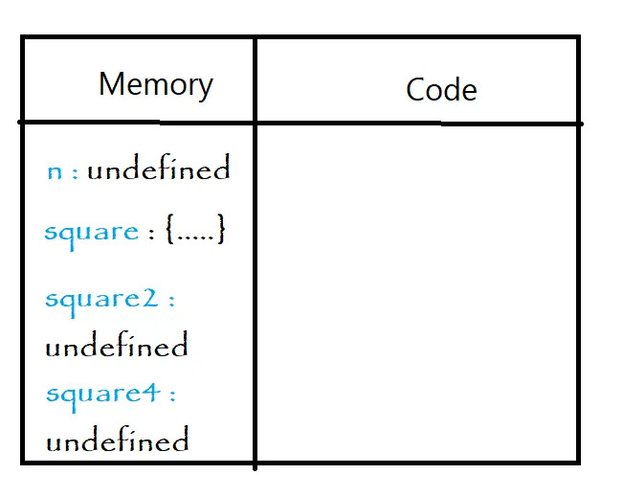
var n = 2;
function square(num) {
var ans = num * num;
return ans;
}
var square2 = square(n);
var square4 = square(4);

Slide 18
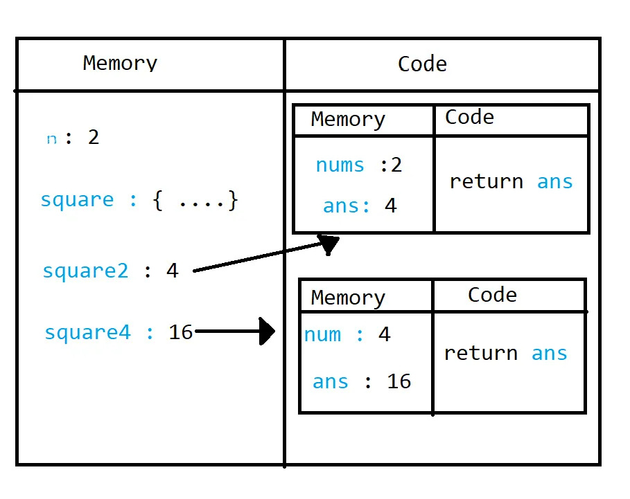
var n = 2;
function square(num) {
var ans = num * num;
return ans;
}
var square2 = square(n);
var square4 = square(4);

Slide 19
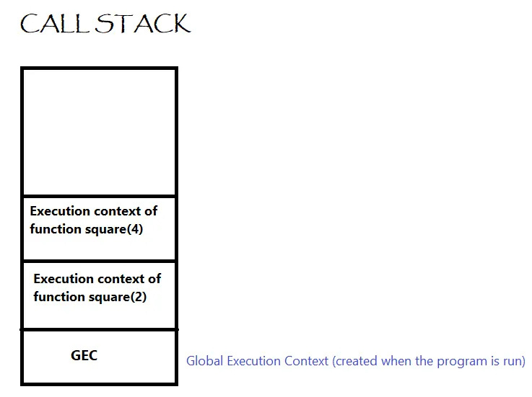
var n = 2;
function square(num) {
var ans = num * num;
return ans;
}
var square2 = square(n);
var square4 = square(4);

Slide 20
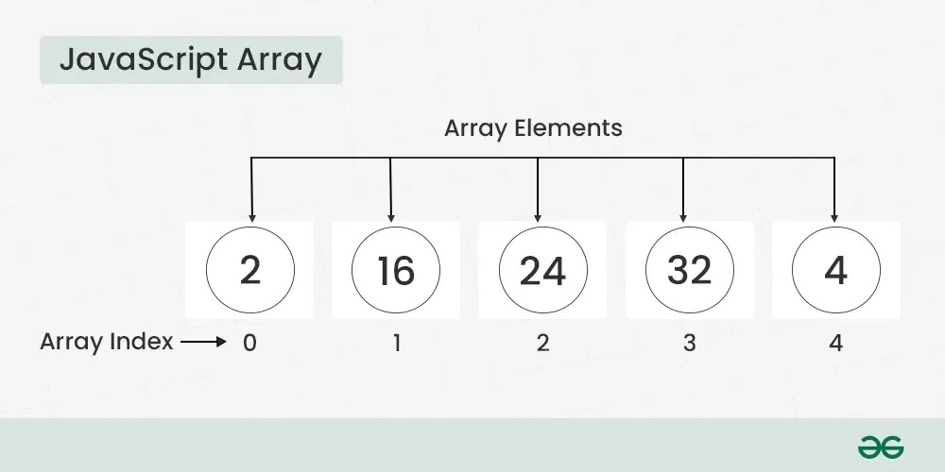
Arrays

Slide 21
Arrays
let arr = [1,2,3,4,5];
let otp = arr.map((x)=>{
return x * 2;
});
console.log(otp);
let arr = [1,2,3,4,5];
let otp = arr.filter((x)=>{
return x == 2;
});
console.log(otp);

Slide 22
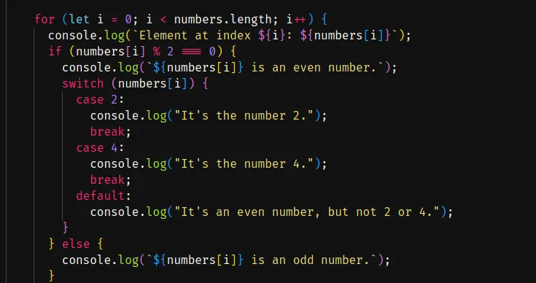
What will be output of this Code ?
let numbers = [ 2, 5 , 8, 4, 22 ];

Slide 23
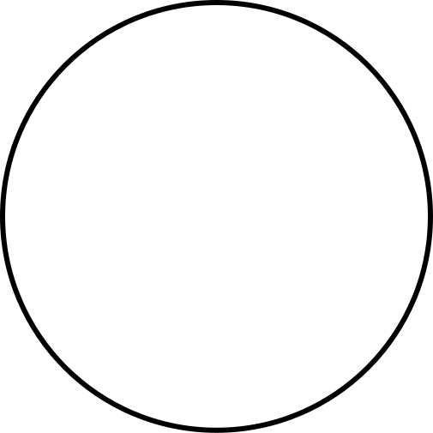
Game time
_
_
_
_
_
_
_

